Slide 1

Predictions of Product Popularity Based on Electronic Product Features
AI FINAL
David Hatcher - Fall 2024

Slide 2
Objective: Using Random Forest model Predict whether a product is popular or not based on its ratings, number of ratings, price, and other product details
Criteria:
ratings
no_of_ratings
actual_price
discount_price

Slide 3
What is RANDOM FOREST?
Machine learning model
Utilizes an ensemble of decision trees to make predictions
Takes a random sample of selected data and then builds a perpetuated series of decision trees on the subsets of data

Slide 4
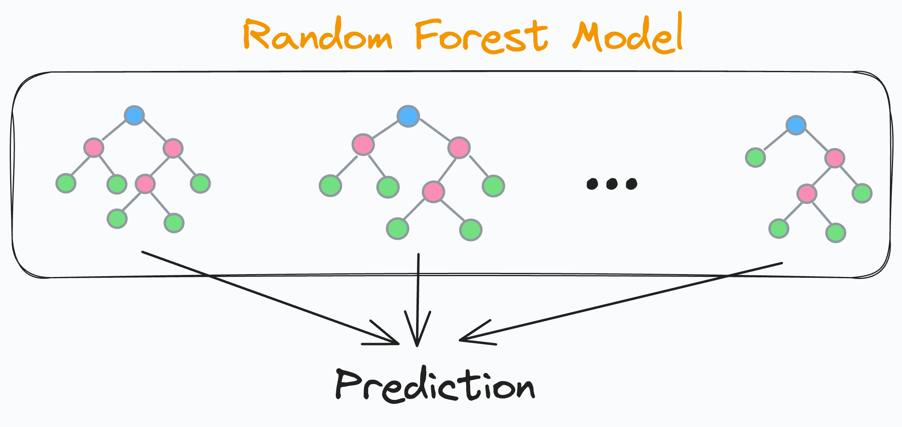
Features of RANDOM FOREST
Feature Importance: can determine the importance of features by keeping track of how much the features contribute to splitting data across tress
Out of Bag Error Estimation: a built-in performance metric that uses data point that are not included in the trees original sample
Random Sampling: ensures diversity in trees by random sample of both data and features (rows and columns)

Slide 5
PRO’s and Con’s
Pro’s: Versatile, Accurate, and Robust
Con’s: Complex and Challenging to Interpret

Slide 6
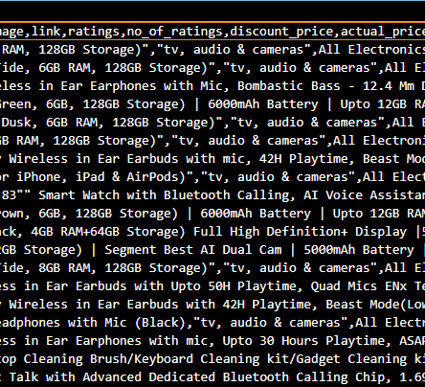
Preprocessing: -Handling missing data -conversion of price columns -creating a target variable

Slide 7
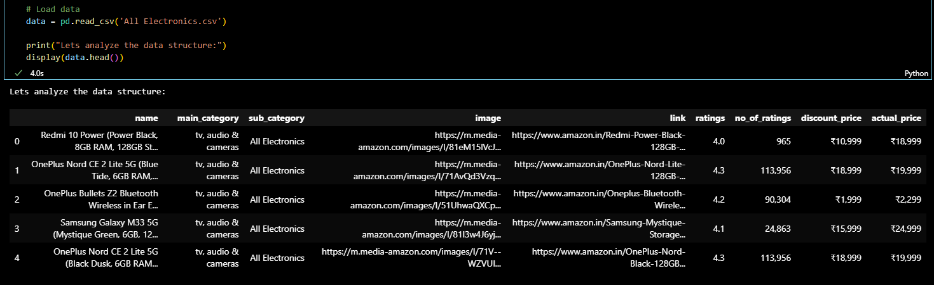
Viewing Data structure

Slide 8
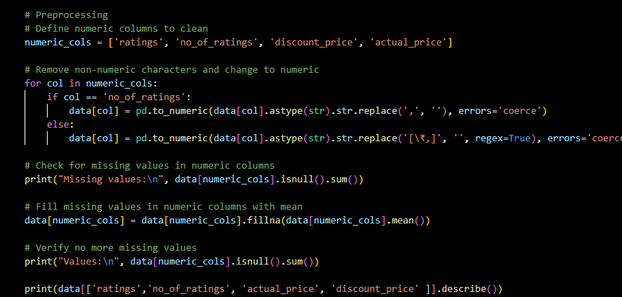
Handling cont…

Slide 9
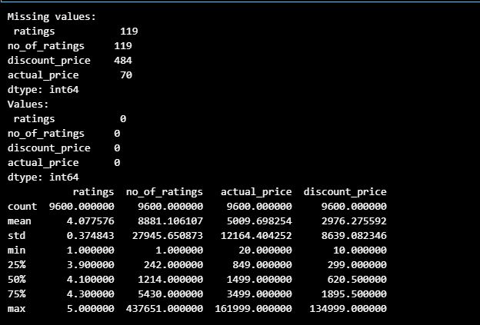
Handling cont…

Slide 10
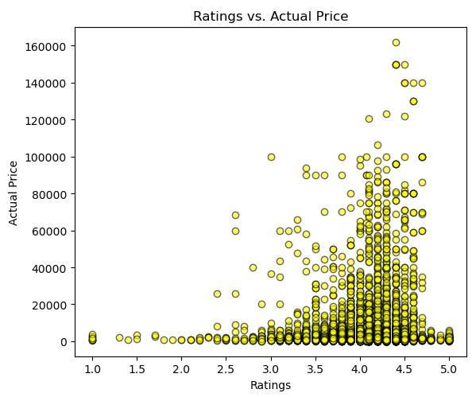
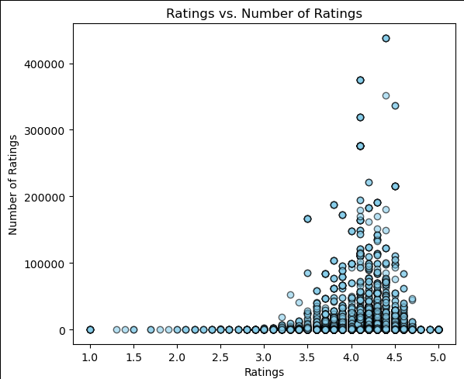
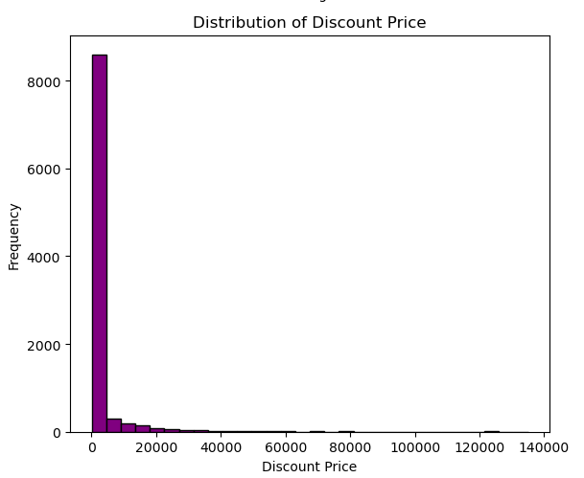
Visualization of outliers

Slide 11
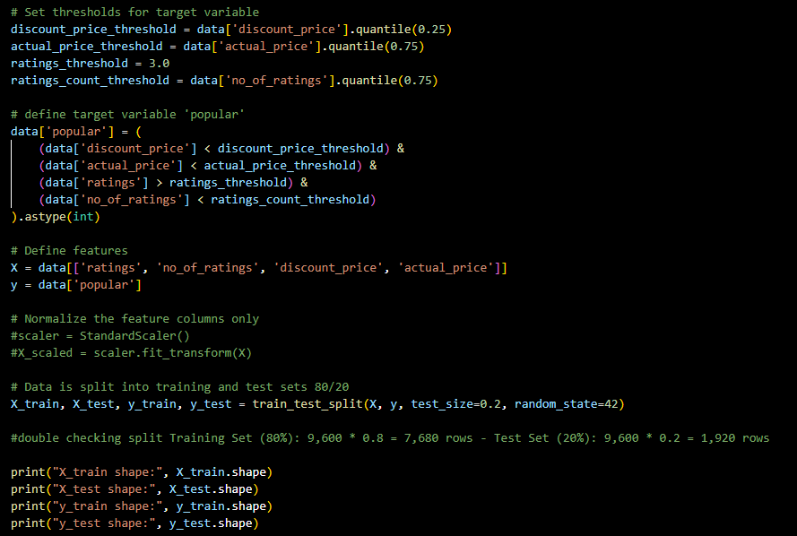
Creating a target variable and defining features

Slide 12
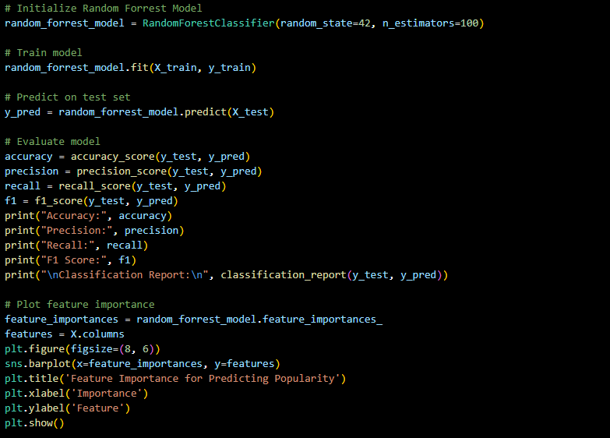
Initialization, training, execution

Slide 13
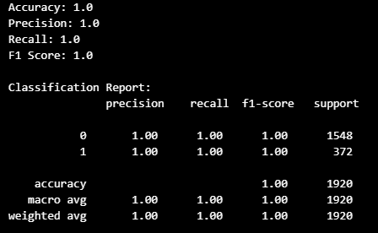
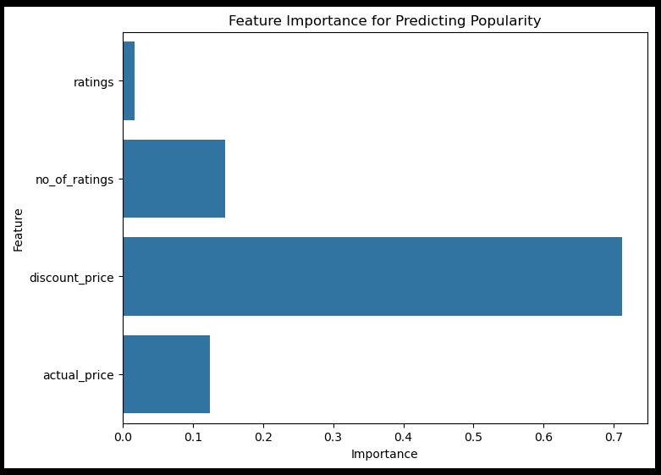
Initial Results

Slide 14
Potential fixes
Tune Hyperparameters: n_estimators, max_depth, min_samples_split, min_samples_leaf, max_features
Edit Features: improves generalization
Cross Validation: use 5-fold cross validation to verify model performance across subsets
Added Measure: data normalization (Improvement of training stability)

Slide 15
TO THE CODE!

Slide 16
Citations:
Chawla, A. (2024, August 3). Reduce trees in random forest model. Reduce Trees in Random Forest Model - by Avi Chawla. https://blog.dailydoseofds.com/p/reduce-trees-in-random-forest-model
Ibm. (2024, October 25). What is Random Forest?. IBM. https://www.ibm.com/topics/random-forest

